Slide 1
Diffusion Tensor Imaging
of the Brain
Neuroscience Foundations for Engineers
Alexandre Carel - Chiara Candiotti
April, 28th 2025

Slide 2
Table of contents
Introduction
Biological principles of water diffusion in brain tissues
Concept of Anisotropy in white matter
The Diffusion Tensor
DTI image acquisition techniques
Key measures derived from the tensor
White matter Tractography
Interpretation of DTI measures in various pathologies
Important clinical applications
Role of DTI in Neurotherapeutics
Limitations
Conclusion

Slide 3
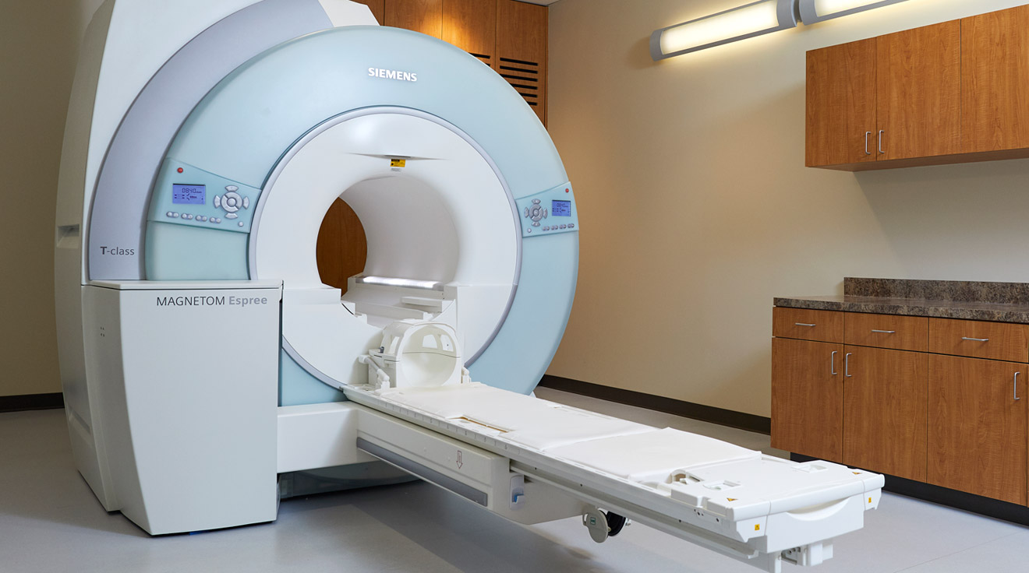

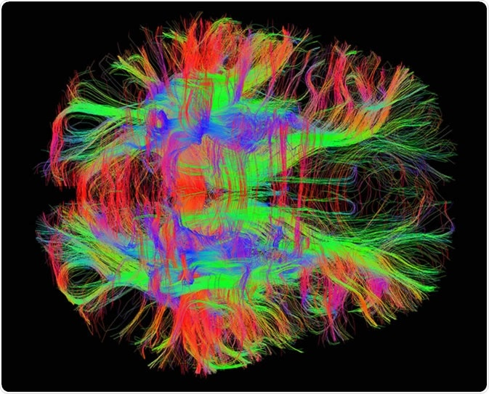
1 - What is DTI ?
+
=
Image Credit: Taylor Ahlborg, https://mri.msjhealth.com/
Image Credit: Trout55, https://www.gettyimages.ch
Image Credit: Zeynep Saygin, mcgovern.mit.edu
Notes:
Regular MRI (Magnetic Resonance Imaging)
Using water
Getting a fully map of the biological tissues (especially in the brain)
Diffusion Tensor Imaging (DTI) is a type of MRI that captures how water molecules move inside tissues, especially in the brain.
In gray matter, water diffuses randomly (isotropic diffusion).
In white matter, water tends to diffuse along the direction of axon bundles — this is anisotropic diffusion.
DTI builds detailed images by mapping this directional water movement.
It allows visualization of white matter tracts — helping us understand brain connectivity and microstructural health.

Slide 4
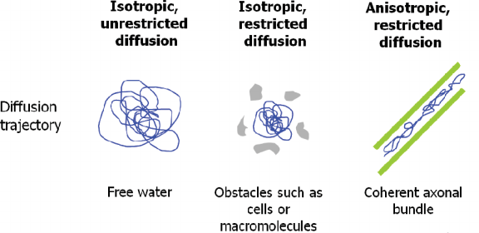
2- Biological Principles of Water Diffusion in Brain Tissues
Image Credit: Christienne Damatac, https://www.researchgate.net/figure/Movement-of-water-molecules-in-different-environments-and-their-respective-diffusion_fig1_233179270
Notes:
In an ideal, unstructured fluid, they move equally in all directions => Isotropic
Water molecules are constantly moving — this is known as Brownian motion.
In unstructured tissues (like cerebrospinal fluid), diffusion is random in all directions (or Isotropic).
In structured tissues like white matter, diffusion is restricted and directional, because axons and myelin sheaths act like barriers.
This means water preferentially moves along the long axis of fibers, rather than across them.
DTI measures this directional movement to infer the organization of brain tissue.

Slide 5
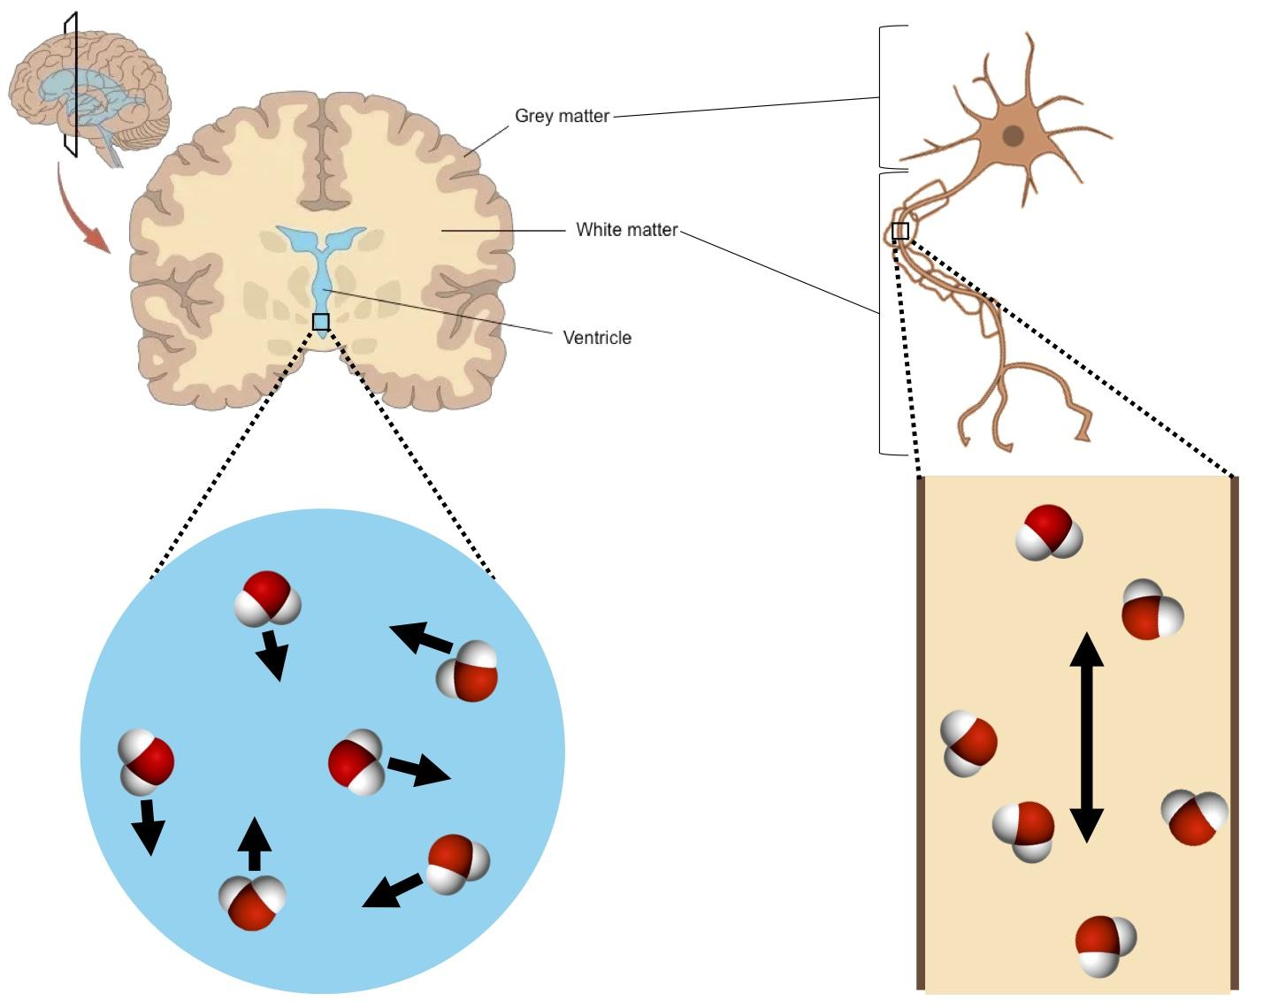
2- Biological Principles of Water Diffusion in Brain Tissues
Image Credit: Christienne Damatac, https://blog.donders.ru.nl/?p=14833&lang=en
Notes:
In an ideal, unstructured fluid, they move equally in all directions => Isotropic
Water molecules are constantly moving — this is known as Brownian motion.
In unstructured tissues (like cerebrospinal fluid), diffusion is random in all directions.
In structured tissues like white matter, diffusion is restricted and directional, because axons and myelin sheaths act like barriers.
This means water preferentially moves along the long axis of fibers, rather than across them.
DTI measures this directional movement to infer the organization of brain tissue.

Slide 6
3 - Concept of Anisotropy in White Matter
In white matter, the direction of diffusion is not uniform (due to inherent structure of axons and myelination +++)
→ follows that of fiber bundles
High fiber density = more aligned diffusion along the fiber direction
Provides insights into the integrity and orientation of neural pathways…
Notes:
Anisotropy simply means that something behaves differently depending on the direction.
In white matter, because of the alignment of fibers and myelination, water moves more easily along the fibers than across them.
High fiber density and good alignment increase this directional movement (high anisotropy).
Measuring anisotropy helps us assess neural pathway integrity — healthy fibers show strong anisotropy; damaged fibers show reduced anisotropy.

Slide 7
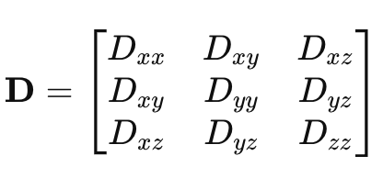
4 - The Diffusion Tensor
A mathematical representation of how water molecules diffuse within a tissue
3x3 matrix that describes the diffusion process in 3D
Along each axis (x, y, z), both the rate and directionality of water diffusion are captured !
Diagonal elements are called the diffusion coefficients

Slide 8
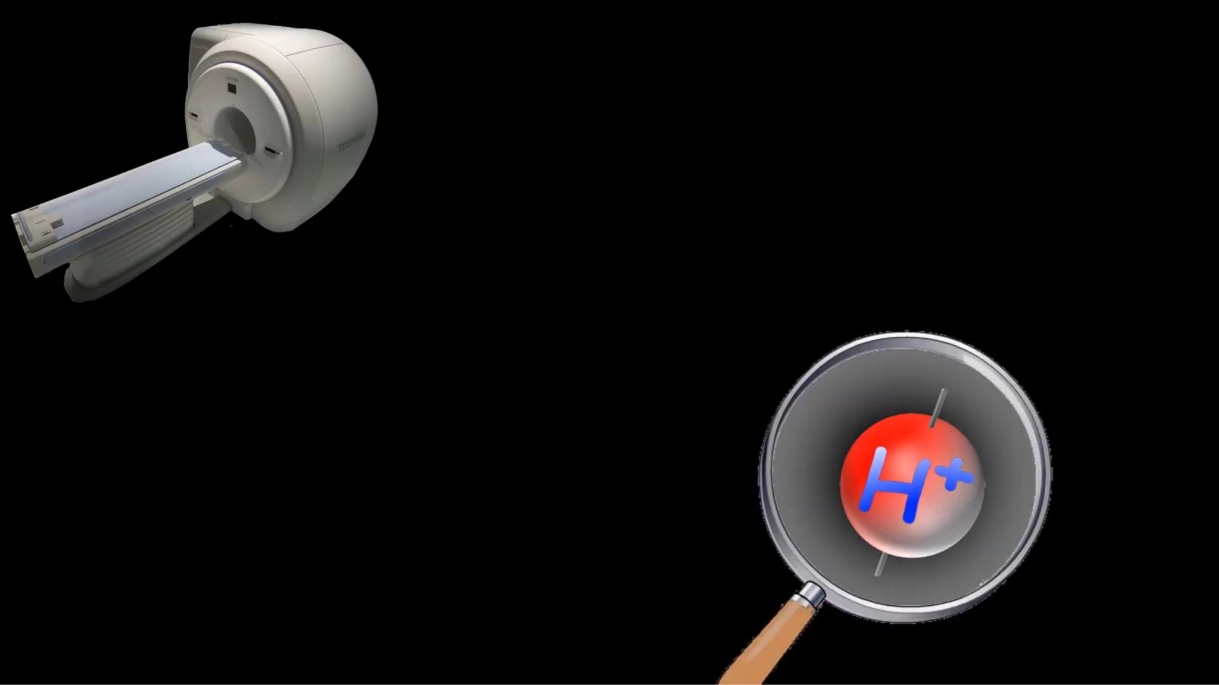
5 - Diffusion-Weighted Imaging (DWI)
Main DTI image acquisition technique
Image Credit: Psyched!, https://www.youtube.com/watch?v=Be51OqnBbdc
Notes:
MRI is great at detecting hydrogen atoms, because they are everywhere in the body, and they have a special property: each hydrogen nucleus (a single proton) acts like a tiny magnet.

Slide 9
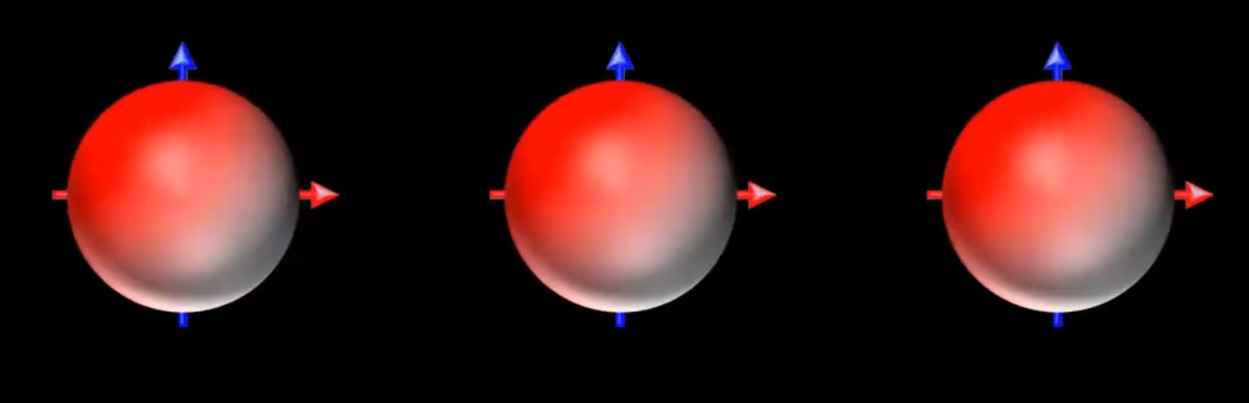
5 - Diffusion-Weighted Imaging (DWI)
Spinning hydrogen protons (view from above)
Image Credit: Psyched!, https://www.youtube.com/watch?v=Be51OqnBbdc
Notes:
Hydrogen protons align to the magnetic field (in parallel or anti-parallel direction) and spin around.
We modify the MRI sequence by adding two strong gradient pulses: one that 'labels' the position of water molecules, and another that tries to 'read' their new position after a short delay.
If a water molecule stays in place, the two gradients cancel out, and there's no signal loss.
How ? Gradient pulses == add extra magnetic fields across space, so that hydrogen atoms at different locations experience slightly different magnetic fields for a moment.
Because the local magnetic field changes, the Larmor frequency (= Their phase (the position in their spin cycle) shifts.) of the protons changes a little bit depending on their position.

Slide 10
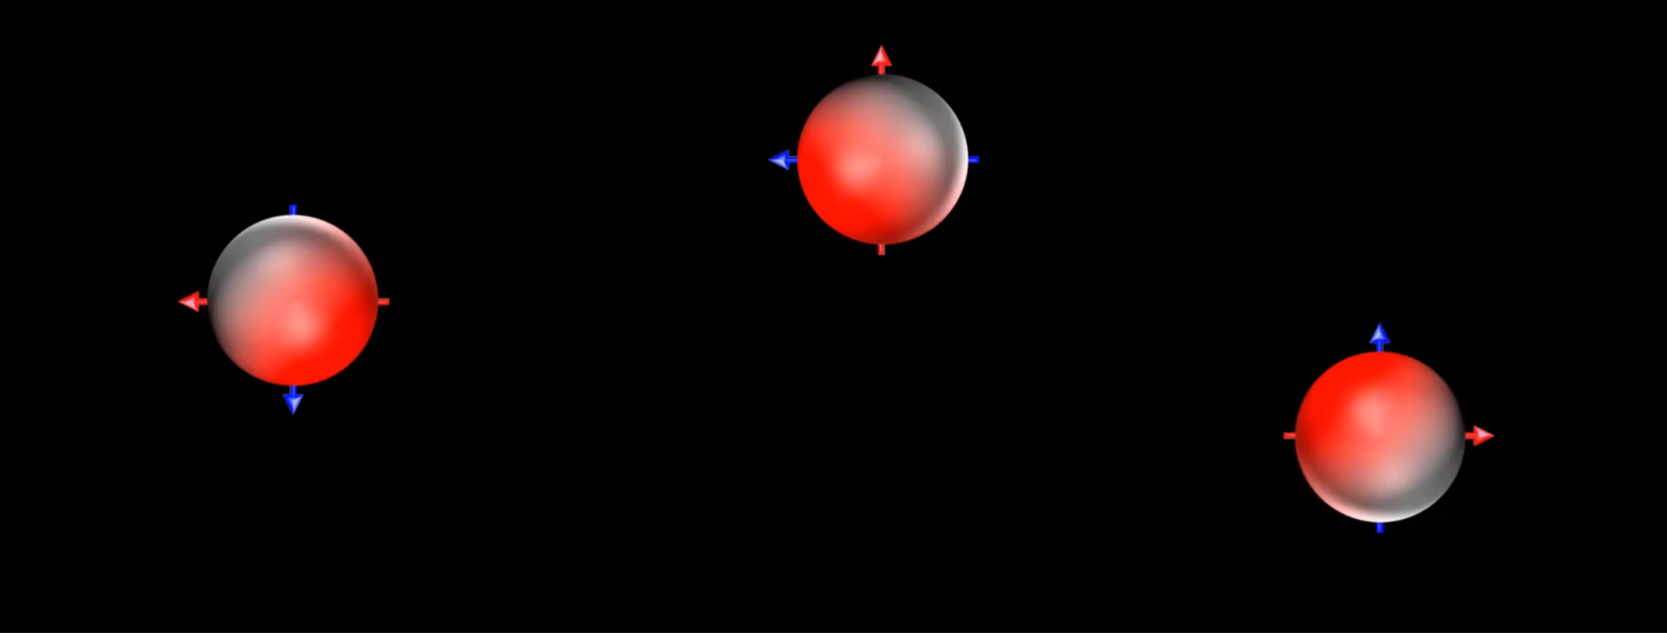
5 - Diffusion-Weighted Imaging (DWI)
After second gradient hydrogen
Image Credit: Psyched!, https://www.youtube.com/watch?v=Be51OqnBbdc
Notes:
But if the water molecule moves (diffuses), the second gradient sees it in a different place, causing the MRI signal to drop. The more movement (diffusion), the greater the signal loss.
Now, in tissues like brain white matter, water moves more easily along the fibers than across them. So if you apply these gradients in different directions, you can see how diffusion varies depending on the orientation.
Usually, we need to measure diffusion along multiple directions to reconstruct the full tensor (as seen in part 4) — typically 30+ directions for good accuracy.
How ? When you try to rephase them with the second pulse, the moving ones don't fully "re-align," and this causes a loss of signal (i.e., diffusion causes signal attenuation).

Slide 11
6 - Key Measures Derived from the Diffusion Tensor
Mean Diffusivity (MD): Average rate of diffusion across all directions.
Fractional Anisotropy (FA): Measure of directional dependence (degree of anisotropy).
Axial Diffusivity (Da): Diffusion along the primary axis of the fibers.
Radial Diffusivity (Dr): Diffusion perpendicular to the fibers.

Slide 12
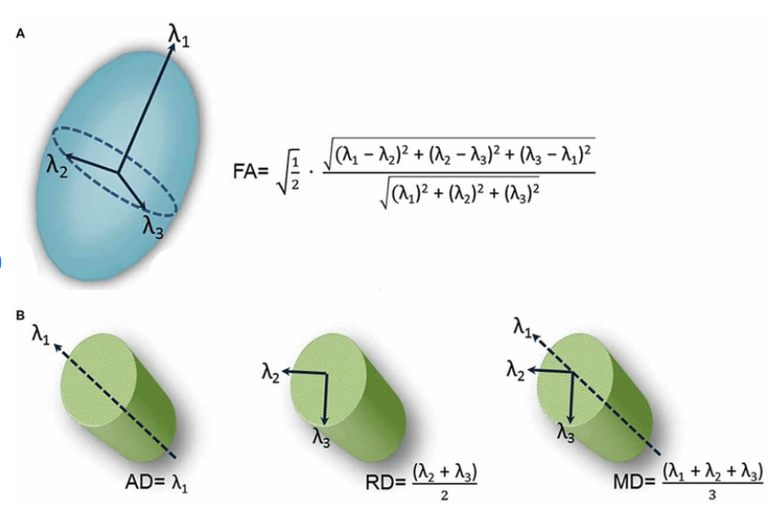
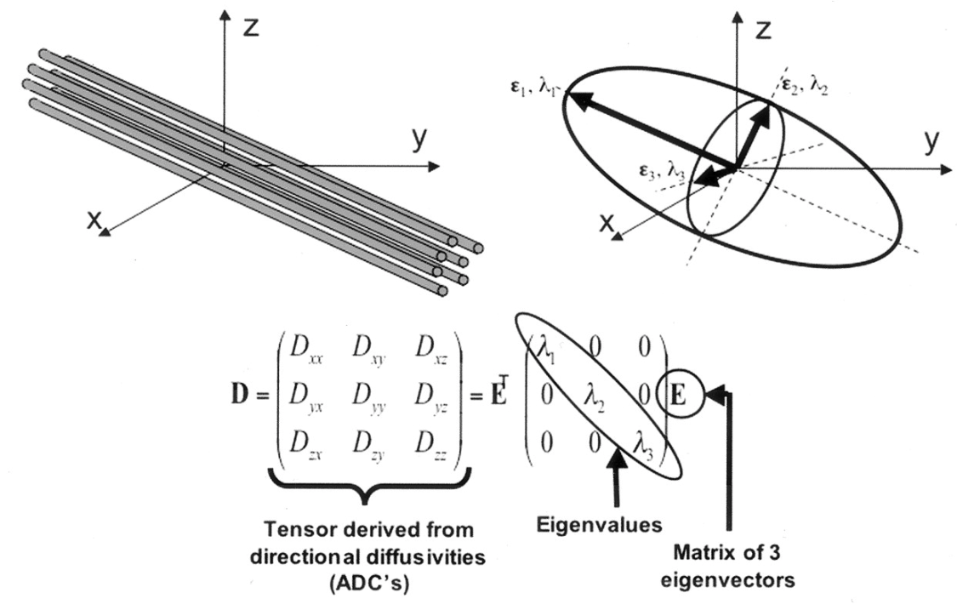
6 - Key Measures Derived from the Diffusion Tensor
Images Credit: Danielle D. DeSouza, https://www.researchgate.net/figure/Schematic-representation-of-diffusion-tensor-images-DTI-derived-metrics-A-schematic_fig5_309307463

Slide 13
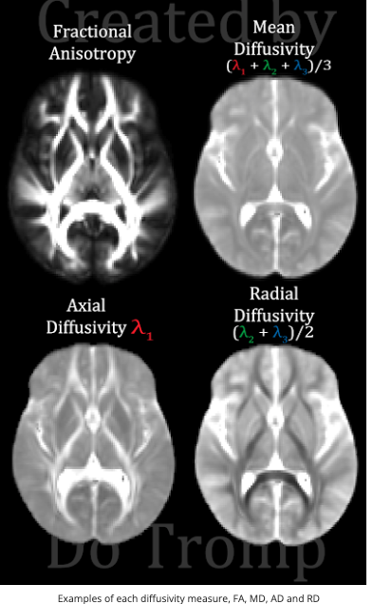
6 - Key Measures Derived from the Diffusion Tensor
Image Credit: Andrew L Alexander, https://pubmed.ncbi.nlm.nih.gov/17599699/

Slide 14
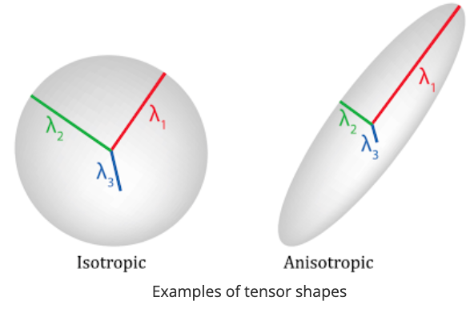
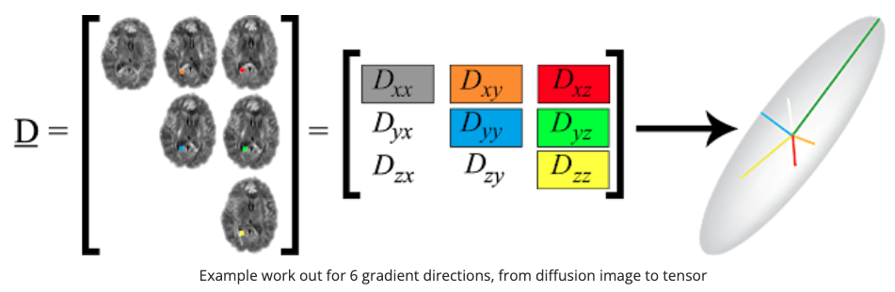
6 - Key Measures Derived from the Diffusion Tensor
Images Credit: Do Tromp, https://www.diffusion-imaging.com/2015/10/what-is-diffusion-tensor.html

Slide 15
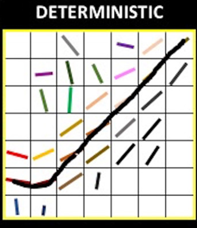
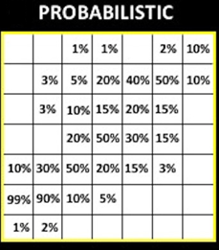
7 - White Matter Tractography
Follows principal diffusion directions
Two main methods
Helps map brain connectivity networks
Images Credit: Jennifer Muller, https://thejns.org/view/journals/j-neurosurg/131/5/article-p1520.xml
Notes:
Tractography uses the diffusion directions captured by DTI to reconstruct virtual “fiber pathways.”
Deterministic methods (uses eigenvector along diffusion tensor at each voxel) are simpler but less accurate in regions with complex fiber crossings.
Probabilistic methods (randomly selects a direction from the distribution of possible fiber orientations, creating a streamline.With multiple streamlines, the algorithm creates a probability map of possible fiber pathways) are more sophisticated, estimating possible pathways considering uncertainties.
Applications include studying normal brain connectivity and disorders like multiple sclerosis, Alzheimer’s, and stroke.
Important limitation: "Crossing fibers" problem — multiple fibers in a voxel can complicate mapping.

Slide 16
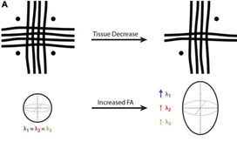
8 - Interpretation of DTI measures in various pathologies
Tissue damage
→ Change in Fractional Anisotropy (FA)
Images Credit: Chase R. Figley, https://www.frontiersin.org/journals/neuroscience/articles/10.3389/fnins.2021.799576/full
Notes:
DTI metrics are sensitive to microstructural changes ⇒ possible detection of pathologies.
Example 1 : Tissue damage
Fractional Anisotropy == A measurement in diffusion tensor imaging (DTI) that quantifies the degree of anisotropy, or directional preference, in water diffusion within a tissue. It essentially reflects how much diffusion is restricted to a specific direction compared to diffusion in all directions. FA values range from 0 (isotropic, no preferred direction) to 1 (highly anisotropic, diffusion is primarily in one direction).
On the left-hand side, FA = 0 because there is no dominant fiber direction (i.e., same diameter, density and integrity of fibers arranged orthogonally), where water diffusion will be constrained equally in all directions.
On the right-hand side, the vertical fibers remain unchanged while the other two fiber bundles (i.e., horizontal and through-plane) are decreased, such that λ1 becomes larger than λ2 and λ3, resulting in an FA increase despite a net white matter fiber reduction.

Slide 17
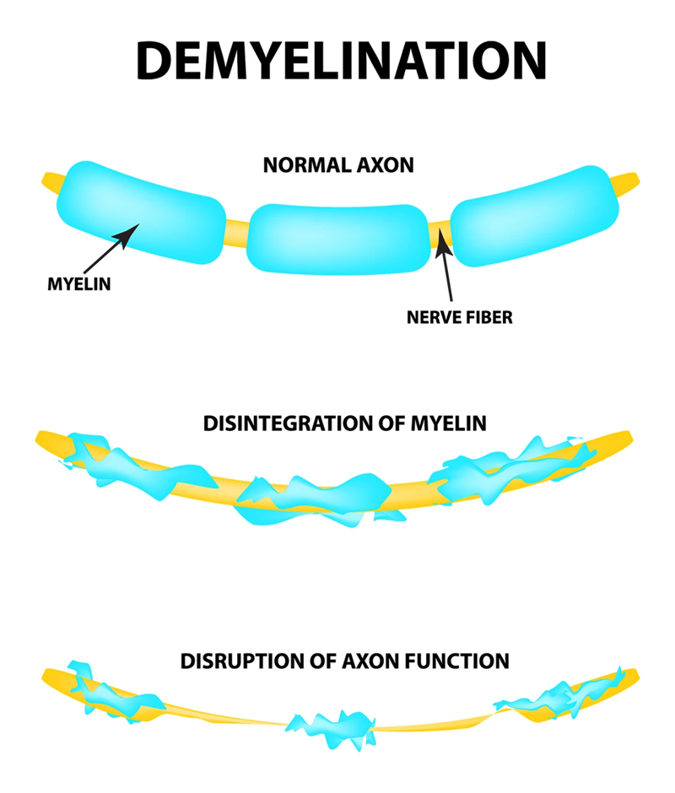
8 - Interpretation of DTI measures in various pathologies
Demyelination
→ Increase in Radial Diffusivity (RD)
Images Credit: No author mentioned, https://www.aurorahealthcare.org/services/neuroscience/neurology/neurological-conditions/neuromuscular-disorders/demyelinating-diseases
Notes:
DTI metrics are sensitive to microstructural changes ⇒ possible detection of pathologies.
Example 2 : Demyelination
What is myelin demyelination ? Your myelin, also known as your myelin sheath, wraps around the axon of a nerve fiber. Axons connect your nerve fibers so they can communicate with each other. Myelin supports the axons in both the central (brain and spinal cord) and peripheral (outside of your brain and spinal cord) nervous systems . This intricate network of nerves is often referred to as "white matter" due to myelin, which provides a white color. 1) Body’s immune system mistakenly attacks myelin. 2) Lack of oxygene damages. 3) Viral infection.
This damage disrupts the transmission of signals through the affected nerves, resulting in a decrease in their conduction ability. Consequently, this reduction in conduction can lead to deficiencies in sensation, movement, cognition, or other functions depending on the nerves affected.

Slide 18
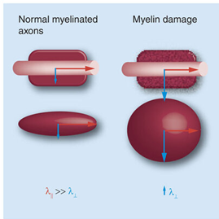
8 - Interpretation of DTI measures in various pathologies
Demyelination
→ Increase in Radial Diffusivity (RD)
Images Credit: Wint Yan Aung, https://www.researchgate.net/figure/Working-model-summarizing-current-findings-of-axial-and-radial-diffusivity-changes-at_fig4_262055808
Notes:
DTI metrics are sensitive to microstructural changes ⇒ possible detection of pathologies.
Example 2 : Demyelination
What is myelin demyelination ? Your myelin, also known as your myelin sheath, wraps around the axon of a nerve fiber. Axons connect your nerve fibers so they can communicate with each other. Myelin supports the axons in both the central (brain and spinal cord) and peripheral (outside of your brain and spinal cord) nervous systems . This intricate network of nerves is often referred to as "white matter" due to myelin, which provides a white color. 1) Body’s immune system mistakenly attacks myelin. 2) Lack of oxygene damages. 3) Viral infection.
This damage disrupts the transmission of signals through the affected nerves, resulting in a decrease in their conduction ability. Consequently, this reduction in conduction can lead to deficiencies in sensation, movement, cognition, or other functions depending on the nerves affected.
Radial Diffusivity == the rate at which water molecules diffuse perpendicular to the main direction of diffusion in white matter tracts.
As image depicts, when RD increase, the myelin is damage, reducing the perpendicular diffusion of molecules (hence less conductivity in the brain).
Most common pathology linked is Multiple Sclerosis. Symptoms : Loss of balance and coordination and Difficulty with cognitive function for instance. It cannot currently be cured, but treatment can often help manage it.

Slide 19
9 - Important clinical applications
Pre-surgical planning
Multiple sclerosis lesion mapping
Brain development studies (particularly in children and adolescents).
Notes:
DTI helps neurosurgeons plan surgeries by showing the relationship between lesions and critical fiber tracts when doing a tumor resection (removal of tumor plus its surroundings tissues).
What tractography can detect : Displacement: The tumor may simply push the tracts aside, without causing significant damage. Deformation: The tracts may be deformed or bent by the tumor's presence. Disruption: In some cases, the tumor may directly invade or even break the tracts.
Tractography helps identify the location and extent of tumor involvement in order to guides the surgical approach, aiming for maximum tumor removal while minimizing damage to the tracts.
Multiple sclerosis : characterize lesions based on their size, location, activity status, and the presence of iron. DTI reveals microstructural white matter damage beyond visible lesions.
How ? T1-weighted images can show lesions as hypointense (dark) regions, reflecting a decrease in signal intensity. T1-images == . Also, Quantitative Susceptibility Mapping (QSM) is a technique that measures the magnetic susceptibility of tissues, allowing for the visualization of iron deposits in lesions. These deposits can indicate chronic inflammation, hence less cerebral activity linked to this pathology.
In pediatrics, DTI tracks brain maturation and helps study developmental disorders (e.g., autism). How ? As the brain develops, myelination (the process of forming a protective sheath around axons) increases, and this is reflected in changes in the diffusion properties of white matter.

Slide 20
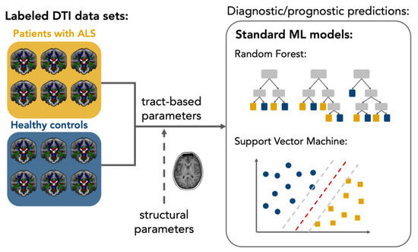
10 - Role of DTI in Neurotherapeutics
Monitoring disease detection
→ Example : ALS patients
Images Credit: Anna Behler, https://www.mdpi.com/1422-0067/24/3/1911
Notes:
DTI metrics can serve as biomarkers for disease monitoring (here is the example in ALS).
DTI + Machine Learning is a very promising tool for early diagnosis, monitoring, and even personalizing neurotherapeutic approaches in ALS. It’s still mostly in research phase but progressing very fast toward clinical use.
What ? Amyotrophic Lateral Sclerosis (ALS) causes progressive degeneration of motor neurons. And DTI is sensitive to microstructural changes in white matter, often before clinical symptoms are severe, so to detect metrics changes like reduced FA and increased MD, which are common across ALS.
How ? Machine Learning (ML) can spot complex patterns across many features (like Fractional Anisotropy, Mean Diffusivity, Axial, and Radial diffusivity in different brain regions) that might not be obvious to human observers. + ML models can be trained to classify individuals (ALS vs healthy controls) or predict disease progression.

Slide 21
11 - Limitations
Sensitivity to noise +++
Resolution constraints
Struggles with accurately depicting crossing fibers
Future developments aim to higher resolution / better algorithms for fiber tracking

Slide 22
Thanks for listening !
Any questions ?

